Slide 1
Introduction to Rhetoric
C.P. English 9

Slide 2
Rhetoric
The art of using language effectively or persuasively
Can you write and speak in a way that causes people to pay attention and actually listen to what you have to say?

Slide 3
The rhetorical appeals
Ethos, Logos, Pathos

Slide 4
Ethos (Ethics)
We tend to believe people we respect; with ethos, the author (or character) tries to convince us that he/she is right simply because he/she is someone worthy of our respect.
He/she is an authority on the subject
He/she is likeable
He/she shares our values
He/she has a good reputation
Any combination of these gives the audience a reason for listening.

Slide 5


Slide 6
Logos (Logic)
Persuading through the use of reasoning
Giving clear reasons is at the heart of good argumentation (rhetoric)
Clear main ideas with specific details, examples, facts, data, or expert testimony

Slide 7
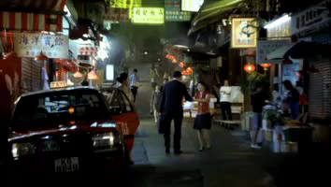

Slide 8
Pathos (Emotions)
Persuading by appealing to the audience’s emotions
To evoke pity or compassion
Imagery that stirs the emotions
Language usage (diction)
Personal stories (anecdotes)
Emotional appeals usually include vivid, concrete descriptions and figurative language (similes, metaphors, personification, etc)

Slide 9


Slide 10
What does it look like when ethos, pathos, and logos come together?

Slide 11


Slide 12
Rhetoric Terms—Devices of Rhetoric
Allusion-a reference to a well-known person, place, or thing from literature, history, etc. Example: Eden, Scrooge, Prodigal Son, Catch-22, Judas, Don Quixote, Mother Theresa, Star Wars

Slide 13


Slide 14
Anaphora-Repetition of a word, phrase, or clause at the beginning of two or more sentences in a row. This is a deliberate form of repetition and helps make the writer's point more coherent.
  Of all the gin joints in all the towns in all the world, she walks into mine." (Rick Blaine in Casablanca)

Slide 15
Anadiplosis – the repetition of a word or phrase from the end of a sentence at the beginning of the next sentence.

Slide 16
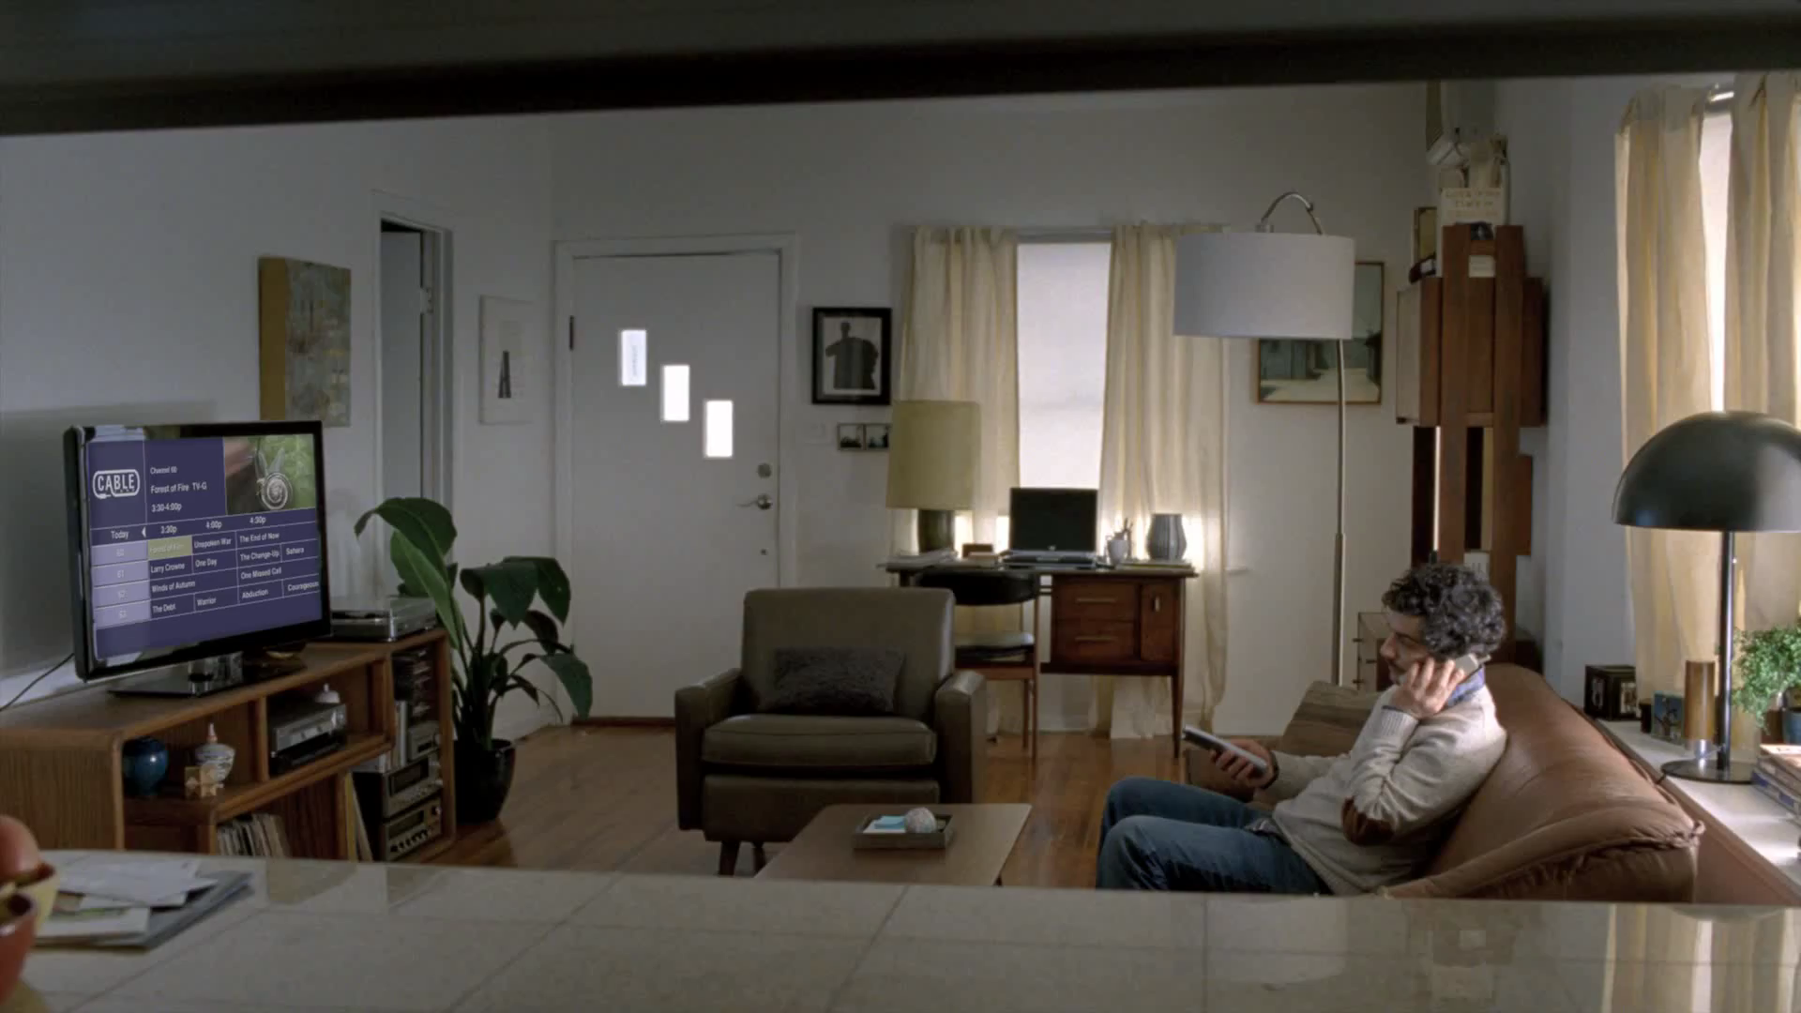

Slide 17
Hyperbole-deliberate exaggeration in order to create humor or emphasis (Example: He was so hungry he could have eaten a horse.)

Slide 18
Parallelism--the technique of arranging words, phrases, clauses, or larger structures by placing them side by side and making them similar in form. Example (from Churchill): "We shall fight on the beaches, we shall fight on the landing grounds, we shall fight in the fields.”
Juxtaposition: Juxtaposition is a literary technique in which two or more ideas, places, characters and their actions are placed side by side for the purpose of developing comparisons and contrasts.

Slide 19
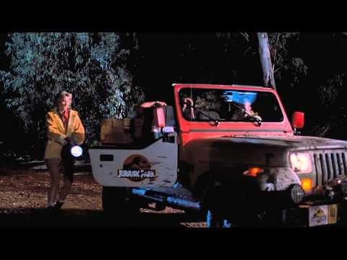
Juxtaposition Example

Slide 20
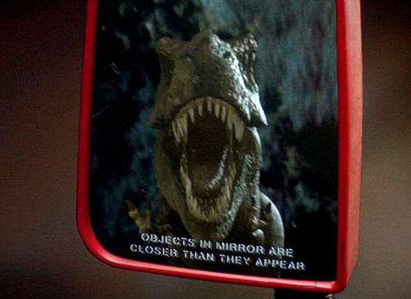

Slide 21
Understatement
An understatement is a figure of speech employed by writers or speakers to intentionally make a situation seem less important than it really is.

Slide 22
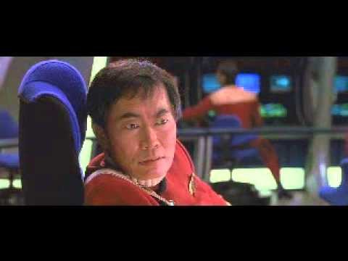
Understatement Example

Slide 23
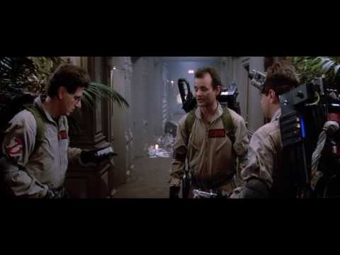
Understatement Example

Slide 24
Other Rhetorical Devices
Alliteration
Assonance
Metaphor
Onomatopoeia
Personification
Simile
Source of Rhetoric Devices terms:
http://quizlet.com/302172/rhetorical- terms-flash-cards/

