Slide 1
Time management pie charts
9th Grade PBL

Slide 2
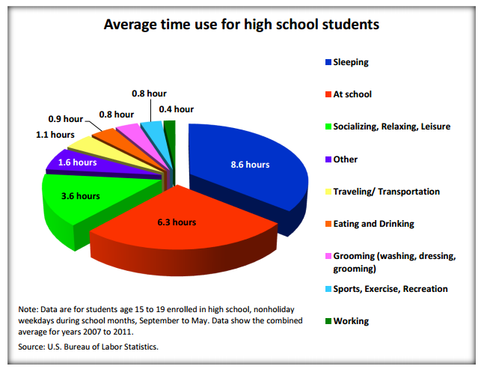
What does this chart represent?
What is it saying?
How much time would the whole circle be?
According to the chart, what percentage of the time does the average student spend sleeping?

Slide 3
Time Management Pie Charts
Now it’s your turn! Make a pie chart that shows how you spend your time in a typical week. Please include the actual time spent (over all 7 days) and the percentage (out of 168 hours) for each piece of your pie.
Make sure to include the following on your chart:
Sleeping
Eating/Drinking
School
Socializing/relaxing/leisure
Traveling/transportation
Grooming (doing hair, showering, dressing, etc.)
Sports/exercise/recreation
Working
Other

Slide 4
Reflection
1. Do you notice any imbalances in your pie chart? Are you spending too much time on something? Are you spending too little time on something? Why or why not?
2. How much of your time is spent doing something for your community? Calculate the percentage of your time.
3. Do you think that you spend enough time helping your community? Why or why not? If not, what could you do to fix that?

